Slide 1
Azure fundamentals
Presented by sai umesh

Slide 2

What is Cloud Computing
Cloud computing is the delivery of different services through the Internet. These resources include tools and applications like data storage, servers, databases, networking, and software.
Rather than keeping files on a proprietary hard drive or local storage device, cloud based service makes it possible to save them to a remote database. As long as an electronic device has access to the web, it has access to the data and the software programs to run it.
Cloud computing is a popular option for people and businesses for a number of reasons including cost savings, increased productivity, speed and efficiency, performance, and security.

Slide 3
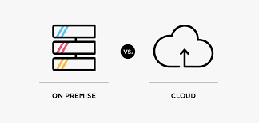
On-premises vs cloud
With on premise software, from implementation to running of the solution, everything is done internally; whereby maintenance, safety and updates also need to be taken care of in-house. Once the software is purchased, it is then installed on your servers; requiring additional power servers, database software and operating systems to be purchased. With no third-party involvement, you assume complete ownership.
With a Cloud-based subscription model, there is no need to purchase any additional infrastructure or licenses. In exchange for an annual fee, a cloud provider maintains servers, network and software for you. The information hosted by the vendor can be accessed through a web portal. The dedicated private cloud allows customers to use the platform completely, with no shared resources. They can request additional customization, backup controls and upgrades.

Slide 4


Why cloud?
Organisations prefer cloud more because of its extraordinary benefits. Some of them include :
Less operational issues
Less capital required
Increased collaboration and productivity
Better work life balance and security
Easy to control and implement

Slide 5
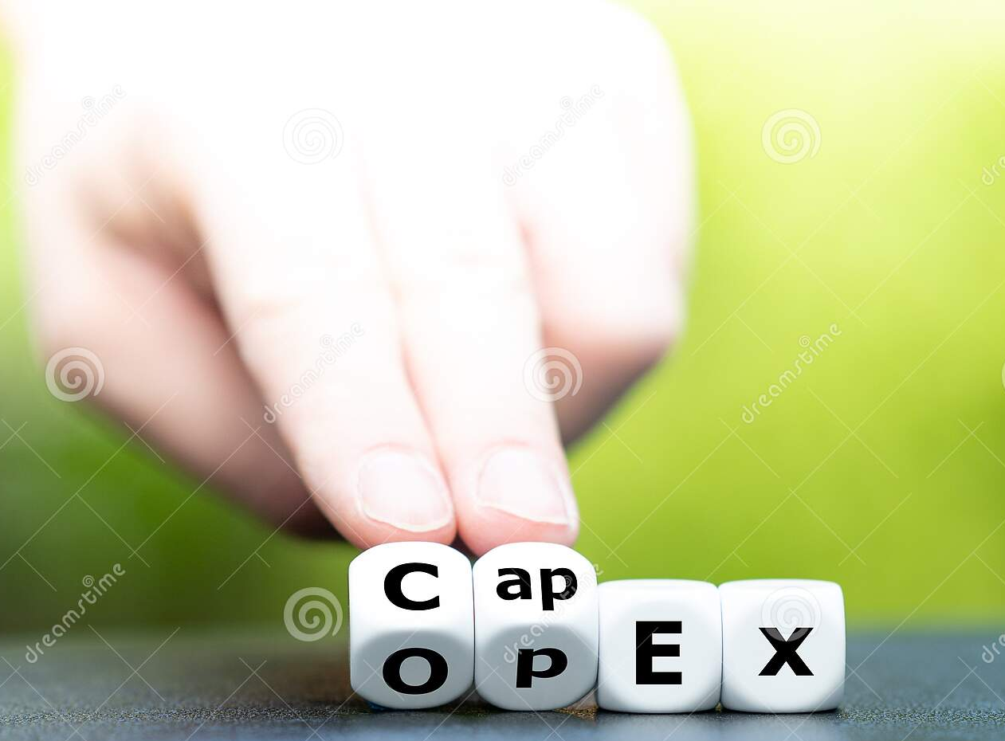
Capex vs Opex
There are a variety of expenses that come with owning and operating a business. These expenses can be separated into different categories. Two of the most common types of expenses are operating expenses and capital expenses.

Slide 6
Opex
Operating expenses are any costs incurred during the course of regular business and are much easier to understand conceptually than capital expenses since they are part of the day-to-day operations.
These include : insurance ,General and administrative expenses, including office supplies, travel, and distribution,Payroll,Research & Development (R&D) ,Cost of Goods Sold (COGS) ,Marketing, Licensing Fees,Utilities,Property taxes

Slide 7
Capex
A capital expenditure is incurred when a business spends money, uses collateral, or takes on debt to buy a new asset or to add value to an existing asset with the expectation of receiving benefits for longer than a single tax year. Put simply, it represents an investment in the business.
These include : Purchases of fixed assets such as buildings or its equipment , upgrading to existing facilities, acquisition of intangible assets, such as patents and other forms of technology.

Slide 8
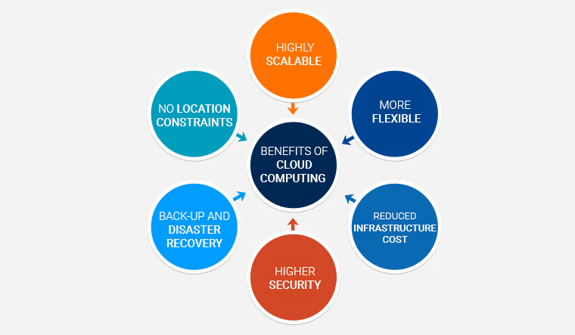
Advantages of Cloud Computing

Slide 9
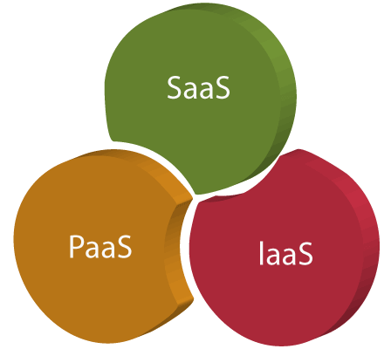
Cloud Models

Slide 10
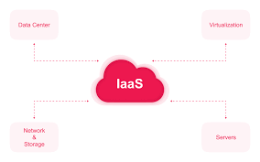
IAAS
IAAS is also known as Hardware as a Service (HaaS). It is a computing infrastructure managed over the internet. The main advantage of using IaaS is that it helps users to avoid the cost and complexity of purchasing and managing the physical servers.
Examples are : Amazon Web Services (AWS), Microsoft Azure, Google Compute Engine (GCE),and Cisco Meta cloud.

Slide 11
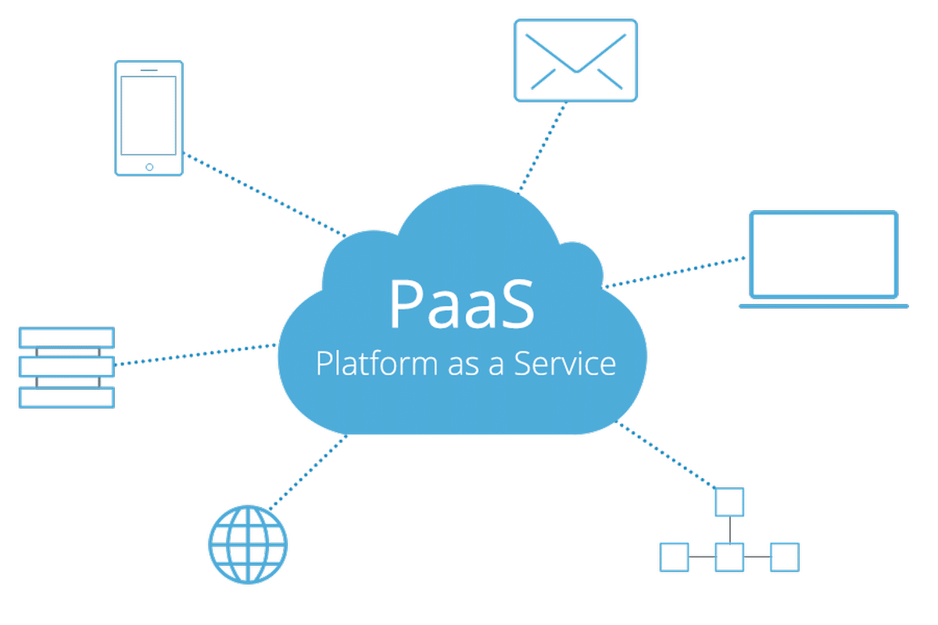
PAAS
PaaS cloud computing platform is created for the programmer to develop, test, run, and manage the applications.
it is Accessible to various users via the same development application ,Integrates with web services and databases.
Builds on virtualization technology, so resources can easily be scaled up or down as per the organization's need.
Support multiple languages and frameworks.
Provides an ability to "Auto-scale".
Examples are : windows azure,Heroku,Google,openshift

Slide 12
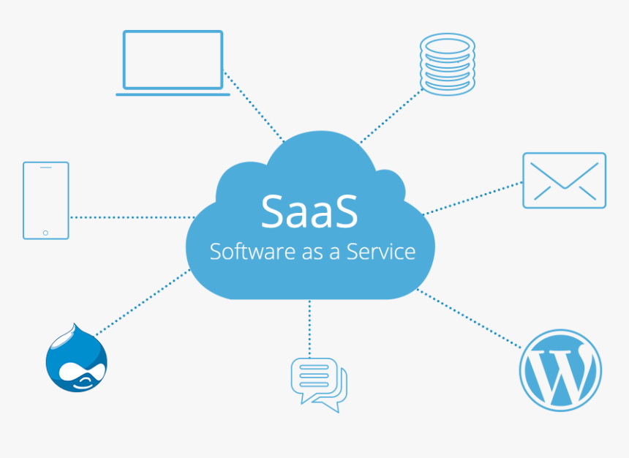
SAAS
SaaS is also known as "on-demand software". It is a software in which the applications are hosted by a cloud service provider. Users can access these applications with the help of internet connection and web browser.
These are : managed from central location, hosted on remote server, accessible over internet, services are pay-as-per-use basis
Examples are :Google Apps, Salesforce, Dropbox, Cisco, WebEx, and GoToMeeting.

Slide 13
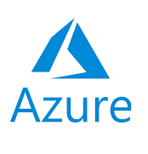
What is Azure ?
Azure is one of the largest cloud providers in the world and is developed by Microsoft
It offers the flexibility to create, manage and deploy apps on a large global network
It provides various services like computing resources , networking resources, serverless computing.

Slide 14
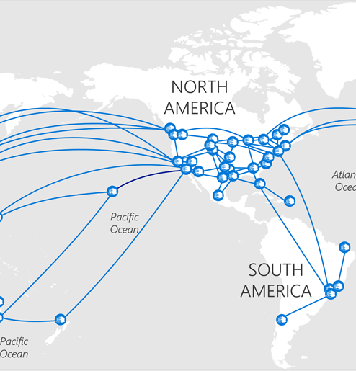
Azure Regions
Azure regions and availability zones are designed to help you achieve resiliency and reliability for your business-critical workloads. Azure maintains multiple geographies. These discrete demarcations define disaster recovery and data residency boundaries across one or multiple Azure regions
Each Azure region features datacentre's deployed within a latency-defined perimeter. They're connected through a dedicated regional low-latency network. This design ensures that Azure services within any region offer the best possible performance and security.

Slide 15


Azure Regions
Americas | Europe | Africa | Asia Pacific
Brazil South | France Central | South Africa North | Australia East
Canada Central | Germany West Central |  | Central India
Central US | North Europe |  | Japan East
East US | Norway East |  | Korea Central
East US 2 | UK South |  | Southeast Asia
South Central US | West Europe |  | East Asia
US Gov Virginia | Sweden Central |  | China North 3
West US 2 | Switzerland North
West US 3

Slide 16
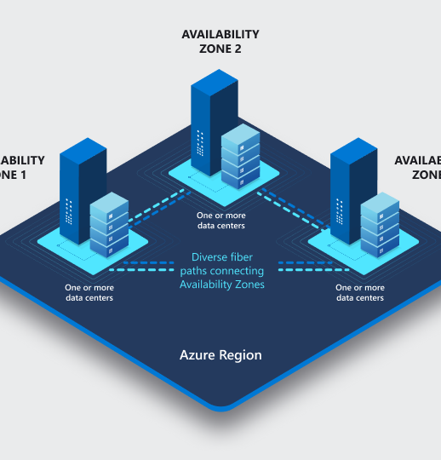
Azure availability zones
Azure availability zones are physically separate locations within each Azure region that are tolerant to local failures. Failures can range from software and hardware failures to events such as earthquakes, floods, and fires.
These are connected through high speed private fibre optic networks, They help your data stay synchronized and accessible when things go wrong.

Slide 17
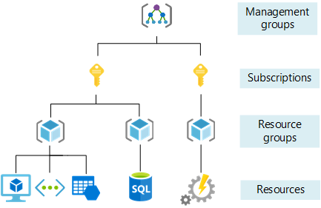
Azure architecture for management of resources
Management groups help you manage access, policy, and compliance for multiple subscriptions. All subscriptions in a management group automatically inherit the conditions applied to the management group.
Subscriptions logically associate user accounts with the resources they create. Each subscription has limits or quotas on the amount of resources it can create and use. Organizations can use subscriptions to manage costs and the resources created by users, teams, or projects.
Resource groups are logical containers where you can deploy and manage Azure resources like web apps, databases, and storage accounts.
Resources are instances of services that you can create, like virtual machines, storage, or SQL databases.

Slide 18
Most important Resources in Azure
Azure Virtual Machines will let us create and use virtual machines in the cloud as Infrastructure as a Service. We can use an image provided by Azure, or partner, or we can use our own to create the virtual machine.
Virtual machines can be created and managed using Azure portal, Azure PowerShell, Azure CLI, client SDK’s , Rest API’s
They also provide configuration services like operating system(windows or Linux),vm size , region, VM extension which gives additional capabilities such as running anti-virus

Slide 19

Azure Virtual Network
Azure Virtual Machines are hosted in an Azure Virtual Network. In Azure, you create your virtual network. If necessary, you may build several virtual networks in Azure. Each virtual network in azure needs to be assigned to an address space.
Example of an address space 15.0.0.0/

Slide 20
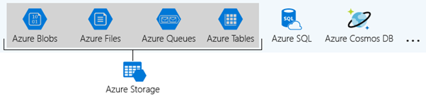
Azure storage accounts
A storage account is a container that bands a set of Azure Storage services together. Only data services from Azure Storage can be comprised in a storage account. Integrating data services into a storage account allows the user to manage them as a group. The settings specified while creating the account, or setting that is changed after creation, is applicable everywhere. Once the storage account gets deleted, all the data stored inside gets removed.

Slide 21
Types of storage accounts
Azure Storage provides different types of storage accounts. Each type supports unique features and has its pricing model. Consider these differences before creating a storage account to work out the best account for the applications. The types of storage accounts are:
General-purpose v1 accounts: Legacy account type for blobs, files, queues, and tables. Use general-purpose v2 accounts instead when possible.
Block Blob Storage accounts: Storage accounts with premium performance characteristics for block blobs and appends blobs. It is recommended for scenarios with high transaction rates or scenarios that use smaller objects or require consistently low storage latency.
File Storage accounts: Files-only storage accounts with premium performance characteristics. Recommended for enterprise or high-performance scale applications.
Blob Storage accounts Legacy Blob-only storage accounts. Use general-purpose v2 accounts instead when possible. Blobs store things in form of objects

Slide 22
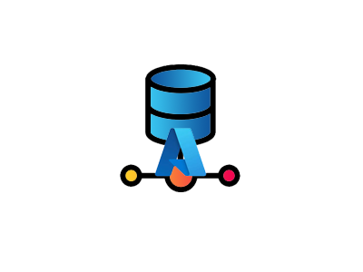
Azure database services
The core database services available in Microsoft Azure revolve around the following five offerings. Cosmos DB, MySQL, PostgreSQL, MS SQL, and SQL Managed Instance. These services cover the range of what any application might need in the cloud today. Whether you need managed relational, NoSQL, in memory, proprietary, or open-source, Azure has a database service to meet any need.

Slide 23
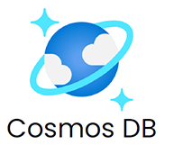
Cosmos DB
Cosmos DB is an extremely popular database offering in Microsoft Azure. It has ultra-low response latency and APIs that integrate with many popular programming languages and database platforms. This means it can function as many other types of databases such as table, SQL, JavaScript API for MongoDB, Gremlin, Cassandra, Spark, and ETCD. The MongoDB interoperability is especially useful. Cosmos DB is a global platform with low latency, fast access, and data convergence.
Scales to 99.999% availability

Slide 24
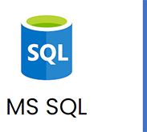
Azure MYSQL
it is a fully managed PAAS database engine that handles most management functions such as upgrading,patching,backups&monitoring
It can be integrated with serverless compute and hyperscale storage to make it a worry free investment.
It can be preferred due to its Robust security and auto scale features

Slide 25
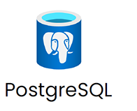
Azure PostgreSQL
Similar in nature to standard MS SQL however it is a service based on the open-source Postgres database engine. Like MS SQL, it is also a managed database as a service offering that can scale to support the most demanding workloads while offering high availability, high security, and excellent performance.

Slide 26
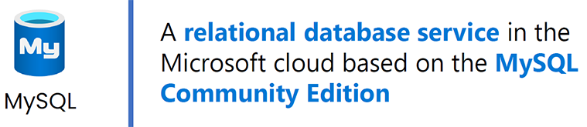
Azure MYSQL
MYSQL has long powered many open source applications online and continues to be a favorite among open source application developers. It is available as a Platform as a Service relational database service in Microsoft Azure. MS SQL, MySQL, and PostgreSQL all look pretty similar in the Azure Portal, and in fact offer comparable features.

Slide 27
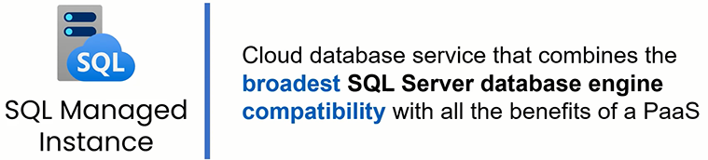
SQL Managed instance
The Azure SQL Managed Instance offers the broadest compatibility with SQL Server database engines with all the benefits of a Platform as a Service. Azure SQL Managed Instance is a good choice for migrating an on premises database to the cloud.

Slide 28
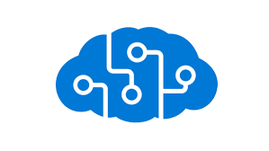
Azure AI services
Azure is already a robust service that covers the development and deployment needs of businesses across the world, but it also holds the capabilities of machine learning. With Azure machine learning, you have access to some of the most advanced machine learning capabilities, including build, train, and deployment learning models that can streamline your work system in no time.
Microsoft is the first to achieve human parity in vision, speech, and language through AI, and machine learning is no different. Using your tools and framework to set up the system, you can develop models faster through automation, manage deployment across the cloud and edge, and tailor everything to the individual needs of your teams. Machine learning works on Windows or Linux, comes in multiple machine learning models, and integrates with other Azure applications and solutions, such as Azure DevOps Services or Azure Pipelines. Since it’s open-source through ONNX, you can quickly move elements between frameworks and hardware platforms. Keep things simple with Azure Machine Learning.

Slide 29
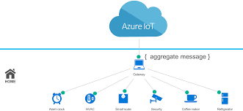
Azure IOT
IoT enables your organisation to analyse and act on data, allowing you to make smart decisions in real-time. With the timely and relevant insights about your business and customers that come with these new sources of data.
In short, IoT lets you solve your business problems using your own data. The Internet of Things is not just about connected devices—it is about the information those devices collect and the powerful, immediate insights that can be garnered from that information. These insights can be used to transform your business and lower costs through improvements like reduction of wasted materials, streamlined operational and mechanical processes or expansion into new lines of business that are only made possible with reliable real-time data

Slide 30
Azure IOT Examples
Remote monitoring: Monitor almost any kind of asset—including heavy machinery, vehicles, and even livestock—almost anywhere, either continuously or at regular intervals
Predictive maintenance: Similar to remote monitoring, predictive maintenance incorporates machine learning software that analyses data to predict outcomes and automate actions.
Facilities management: This IoT scenario is focused on monitoring your buildings, infrastructure and other spaces, allowing you to improve energy efficiency, space utilisation, productivity and safety using the data you collect
Manufacturing efficiency: Every business is different, but many manufacturing processes share a common pathway from raw materials to finished products. With IoT, it's possible to learn from your own systems find new ways to manage your processes and product quality with data from your devices and sensors.
Connected products: Connected products have smart, connective components that allow data to be exchanged between the product and its user, manufacturer or environment. Related IoT solutions may help you build smart factories with new functionality, greater reliability and higher product utilisation

Slide 31
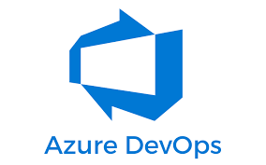
Azure Devops
Azure DevOps provides developer services for allowing teams to plan work, collaborate on code development, and build and deploy applications. Azure DevOps supports a collaborative culture and set of processes that bring together developers, project managers, and contributors to develop software. It allows organizations to create and improve products at a faster pace than they can with traditional software development approaches.
You can work in the cloud using Azure DevOps Services or on-premises using Azure DevOps Server.

Slide 32
Big data analytics on azure
Microsoft Azure provides robust services for analyzing big data. One of the most effective ways is to store your data in Azure Data Lake Storage Gen2 and then process it using Spark on Azure Databricks.
Azure Stream Analytics (ASA) is Microsoft’s service for real-time data analytics. Some examples include stock trading analysis, fraud detection, embedded sensor analysis, and web clickstream analytics. ASA uses Stream Analytics Query Language, which is a variant of T-SQL. That means anyone who knows SQL will have a fairly easy time learning how to write jobs for Stream Analytics.

